Slide 1
Decomposition Of Game
Koshtura Diana, Podlesna Lilia

Slide 2
Running Student Game Adventure game It is a good idea to develop a plan when creating a game.

Slide 3
First Step
Description of our new game

Slide 4
Student from university – Running Student – get lost in big university and you want to help him escape through the exit on the top floor. The game has a figure that can run from left to right and jump. There platforms on each floor that he must jump to. The goal of the game is to reach the door to the exit, before it is too late and the game ends.

Slide 5

Second Step – Creating The Game Elements

Slide 6
- Preparing a transparent image; - Drawing Running Student; - Drawing the platforms; - Drawing the door; - Drawing the background; - Transparency;

Slide 7
Based on description we know we need several images. Wee will obviously need code to pull all this together, but before we get there, we will create graphics for out game. Sprites are the things in a game – typically a character of some kind. Sprites are usually prerendered, meaning they are drawn in advance rather than being created by the program.

Slide 8

Third Step

Slide 9
- Creating the game class; - Creating the cords class; - Cheking for collisions; - Sprites colliding vertically; - Putting it all together; - Creating the sprite class; - Adding the platforms;

Slide 10

Step Fourth – Creating Running Student

Slide 11

Moving
Initializing the Figure;
Turning the Figure left and right;
Making the Figure jump;
What we have so far

Slide 12
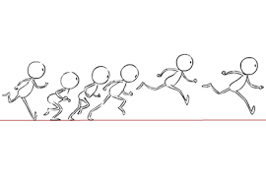
Fifth Step
Animating the Figure;
Animation function;
Getting position;
Making Figure move;

Slide 13
Sixth Step
Tesing our Figure sprite;
THE DOOR

Slide 14
Running the program … but it is not the end

Slide 15
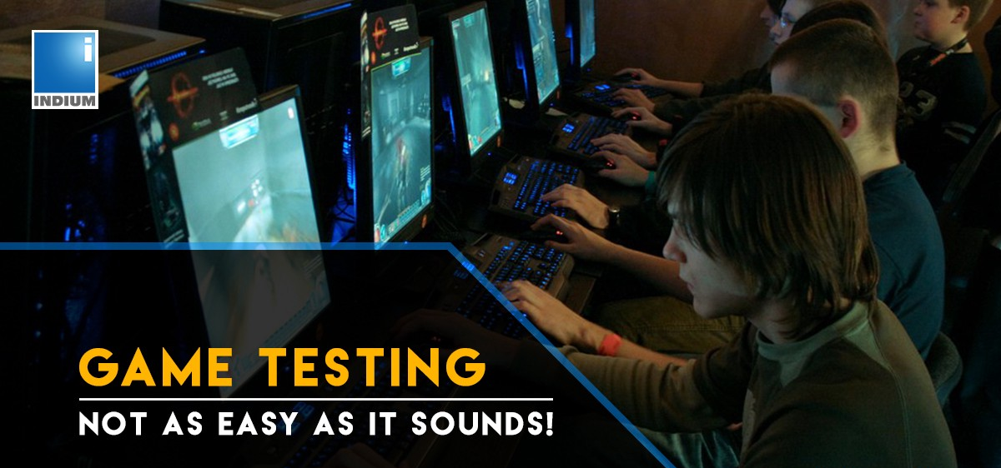
Because

Slide 16
Last Step!!!!
The final game;
What we learned;

Slide 17

Thank You!

